Slide 1
Attack, Defense & Analysis of a Vulnerable Network Junior Stanley Paruthiyil

Slide 2
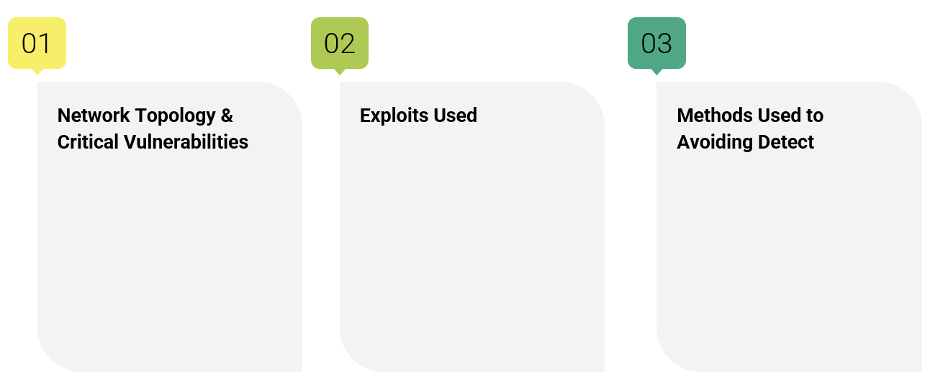
Table of Contents
This document contains the following resources:

Slide 3

Network Topology
& Critical Vulnerabilities RED TEAM ANALYSIS
3

Slide 4
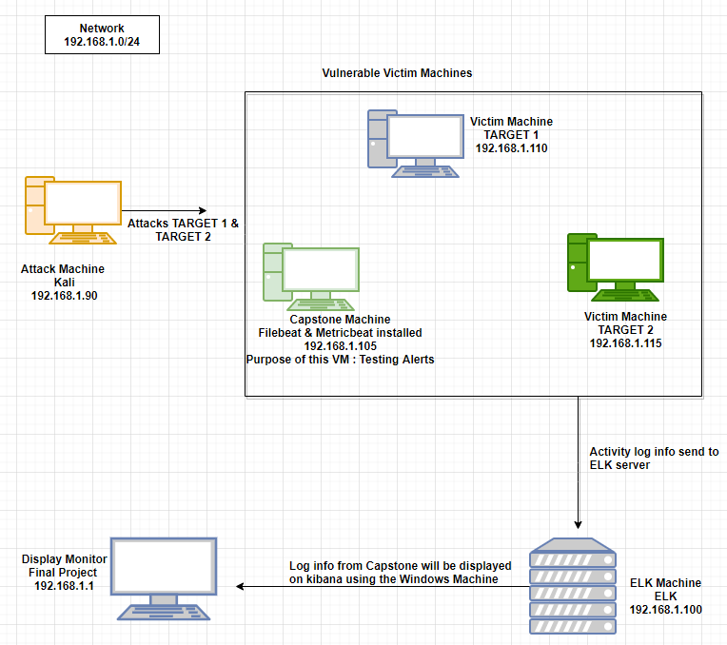
Network Topology
Network
Address Range: 192.168.1.0/24
Netmask: 255.255.255.0
Gateway: 192.168.1.1
Machines
IPv4: 192.168.1.90
OS: Debian Kali 5.4.0
Hostname: Kali
IPv4: 192.168.1.110
OS: Debian GNU/Linux 8
Hostname: Target 1
IPv4: 192.168.1.115
OS: Debian GNU/Linux 8
Hostname: Target 2
IPv4: 192.168.1.105
OS: Ubuntu 18.04
Hostname: Capstone
IPv4: 192.168.1.100
OS: Ubuntu 18.04
Hostname: ELK

Slide 5
Critical Vulnerabilities: Target 1
Our assessment uncovered the following critical vulnerabilities in Target 1.
Vulnerability | Description | Impact
WordPress XMLRPC pingback | Can be exploited by a simple POST to a specific file on an affected WordPress server | Target internal layers, change configuration on devices
WordPress XMLRPC DoS CVE-2014-5266 | WordPress XMLRPC parsing is vulnerable to a XML based denial of service | It affects WordPress 3.5 – 3.92
WordPress XML-RPC Username/Password Login Scanner CVE-1999-0502 | Attempts to authenticate against a WordPress-site (via XMLRPC) using Username and password combination | Access for login

Slide 6
Critical Vulnerabilities: Target 1
Our assessment uncovered the following critical vulnerabilities in Target 1.
Vulnerability | Description | Impact
WordPress Pingback Locator CVE-2013-0235 | Will scan for WordPress sites with the Pingback API enabled | Scan for WordPress sites with the Pingback API enabled
Cron WordPress Attacks | Pingback feature which is enabled by default can be used by booters to attack other websites | Could not only attack other target website but also potentially slow down or even crash your website if heavily misuse
WordPress version 4.8.7 vulnerability | Insecure version | Unpatched version can be exploited through numerous vulnerabilities

Slide 7
Critical Vulnerabilities: Target 2
Our assessment uncovered the following critical vulnerabilities in Target 2.
Vulnerability | Description | Impact
Brute -forceable URL directories and files | This vulnerability allows for brute force guessing of which directories a system has | By discovering the directories of a system, this gives away the structure of the system.
Netcat reverse shell/remote execution vulnerability | Combining a bash script, a netcat listener, and the web browser access of the system, implementing a reverse shell was possible. | The reverse shell gave unauthorized remote access to the system
Unrestricted access to WordPress directories | Once on the system there was no restricted access to the files or directories | This completely exposed the system and all of its directories and files to anyone who happened to gain authorized or unauthorized access.
Local File Inclusion | Used LFI to push backdoor.php listener to web server | This completely exposed the system and all of its directories and files to anyone who happened to gain authorized or unauthorized

Slide 8
Exploits Used Target 1
8

Slide 9
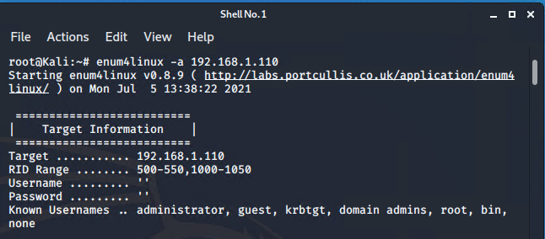
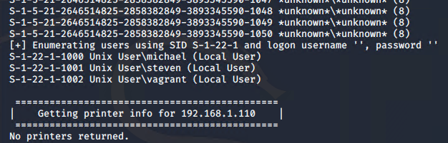
Exploitation: Open port 22 and Weak Password
We used wpscan to find the users and guessed the weak password in order to
SSH into the system or enum4linux -a 192.168.1.110
The exploit granted us user shell access for Michael’s account. We explored the files to find flags 1 and 2.

Slide 10
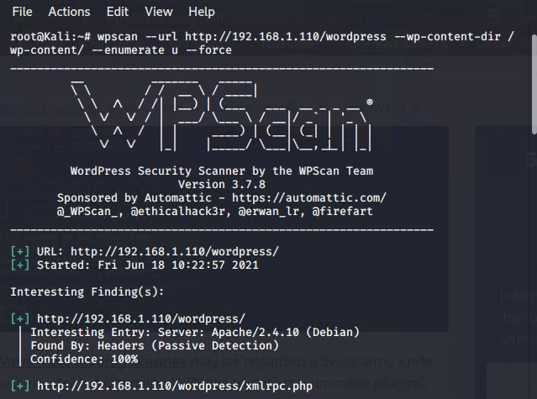
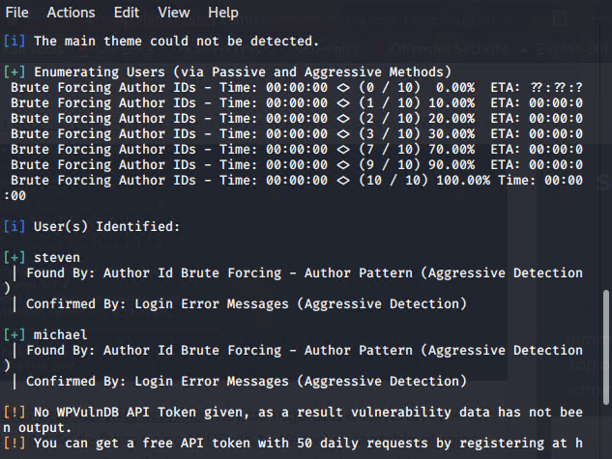

Slide 11
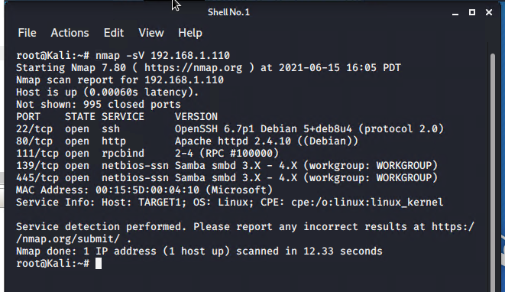
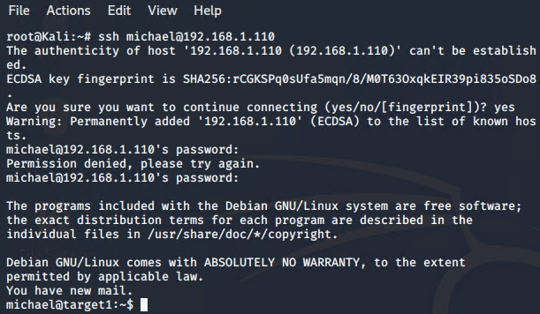
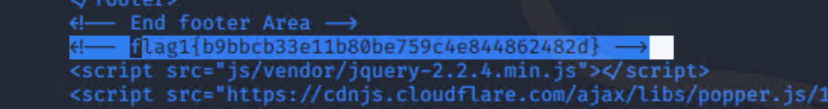
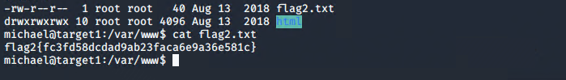

Slide 12
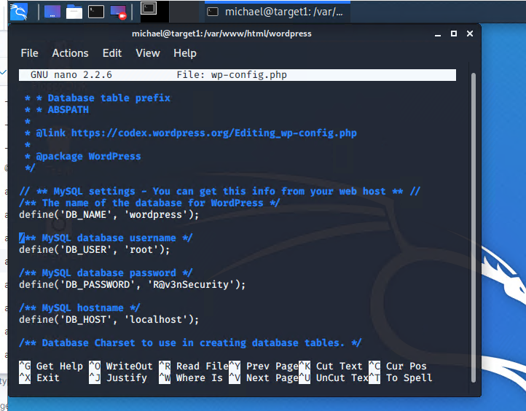
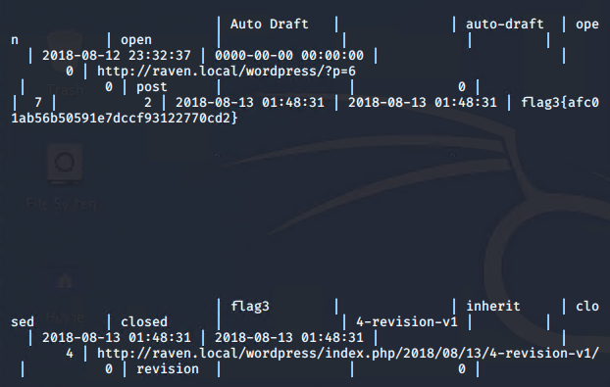
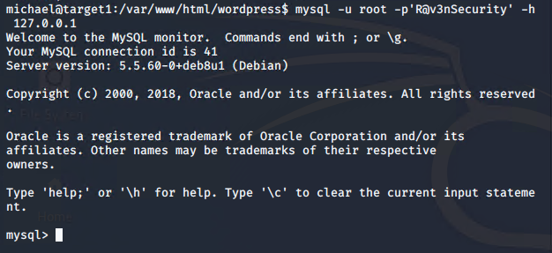
Exploitation: WordPress Configuration and SQL Database
The username and password to access the SQL database were in plaintext in
the wp-config.php file and not hashed as is best practice.
The exploit granted us mysql access and allowed us to find flag 3.

Slide 13
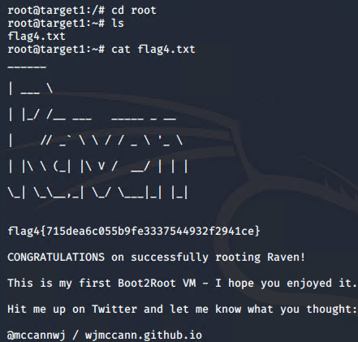
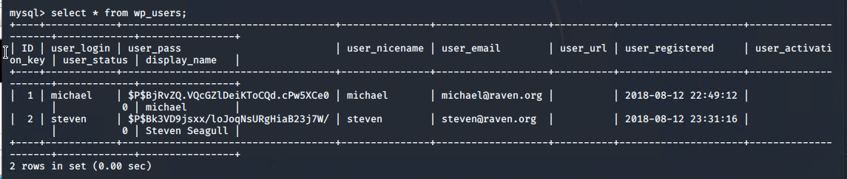
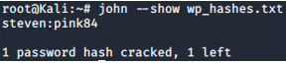
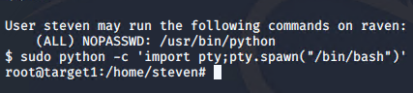
Exploitation: Privilege Escalation
● We obtained Steven’s password hash from the SQL database
● We cracked the password using John the Ripper and accessed his account
● We exploited Steven’s python sudo privileges through a spawn shell
● The exploit achieve root access and allowed us to find flag 4

Slide 14
Exploits Used Target 2
14

Slide 15
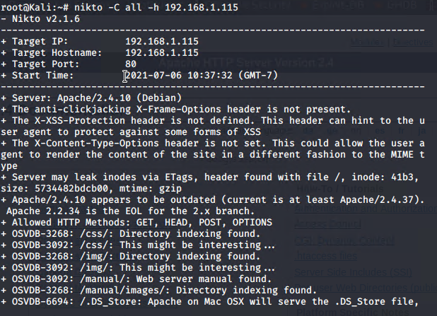
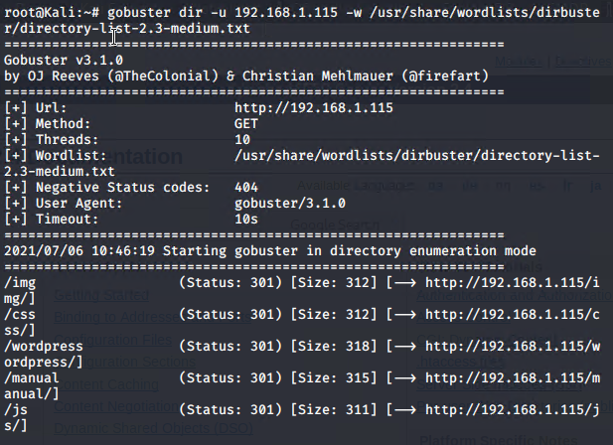
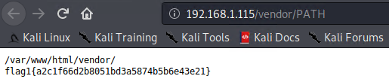
Exploitation: Directory Exploration
Brute -forceable URL directories and files by tool gobuster
Got access into directories and files and gained critical information and found flag1.
Used nikto to access files and directories

Slide 16
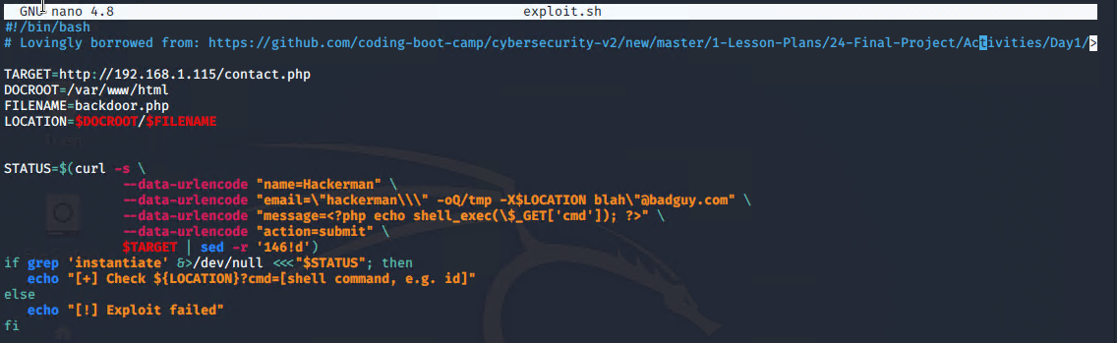
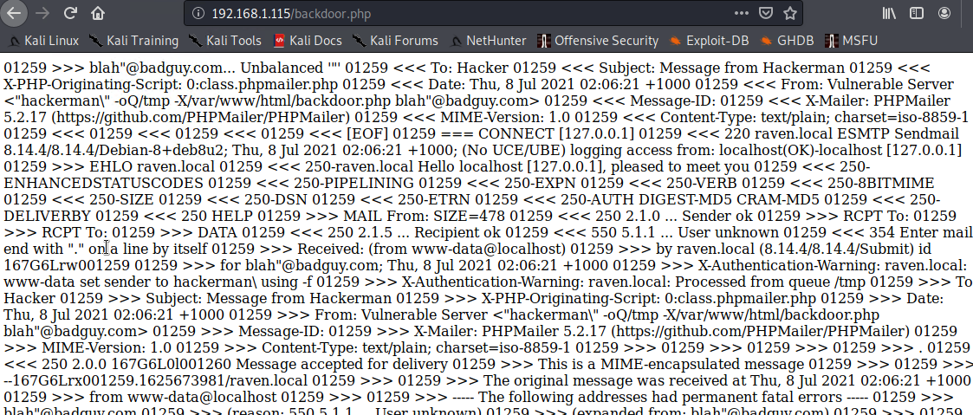
Exploitation: Netcat reverse shell/ remote execution vulnerability
Utilized the exploit.sh script to insert a backdoor php file into the vulnerable web server

Slide 17
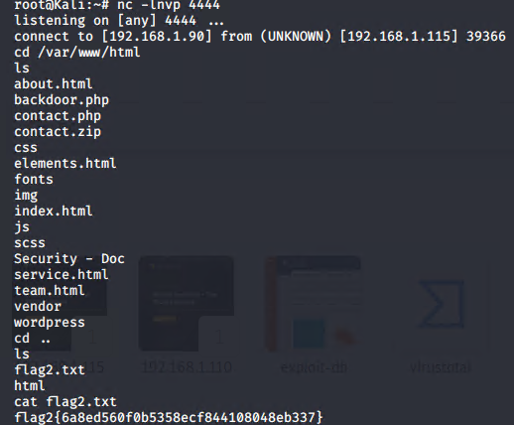
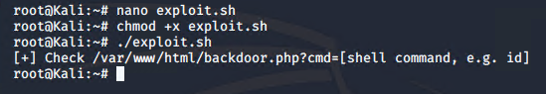
Net cat gave remote access to the target 2 and found flag2

Slide 18
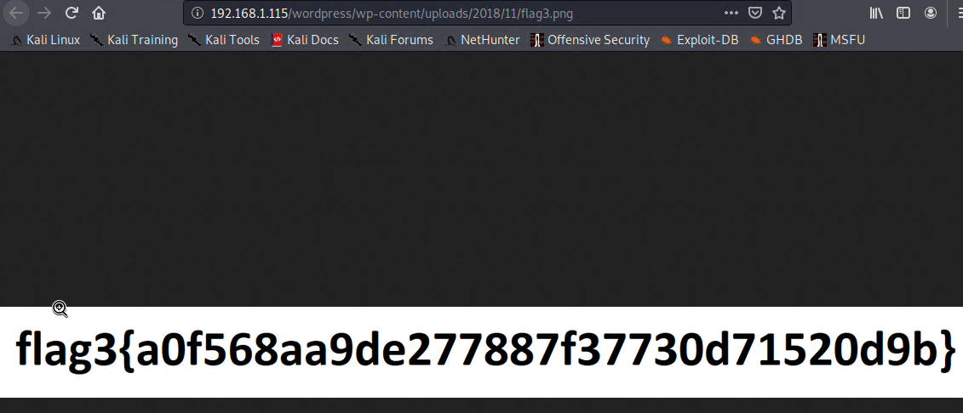
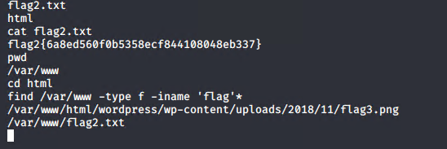
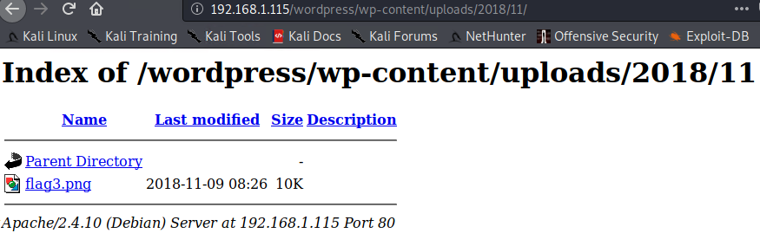
Exploitation: Unrestricted access to WordPress directories
Able to access the wordpress directories and find flag 3

Slide 19
Avoiding Detection
In Target 1
19

Slide 20
Stealth Exploitation of open port 22 SSH and Weak Password
Monitoring Overview
SSH Login Alert would detect this alert
Monitor SSH Port for unauthorized access
Triggers when user attempts to access system over Port 22
Mitigating Detection
SSH through a different open port that is less obvious
Reverse shell exploit is an another way of exploiting

Slide 21
Stealth Exploitation of WordPress Configuration and SQL Database
Monitoring Overview
SQL Database Alert
Monitor server traffic for unauthorized attempts to access SQL Database
Triggers when external/unauthorized IP connections are made to the SQL Database or any related files.
Mitigating Detection
Employ IP address spoofing
Brute-force SQL Database with Password cracking tool, Connect to the same
network

Slide 22
Stealth Exploitation of Privilege Escalation
Monitoring Overview
Privilege Escalation Alert
Monitor unauthorized root access attempts as well as “super-doer” activity
Triggers when unauthorized sudo command usage or privileged directory access is attempted by unauthorized users
Mitigating Detection
Finding vulnerabilities in the kernel and exploiting them for root access

Slide 23
Avoiding Detection in Target 2
23

Slide 24
Stealth Exploitation of Brute-forceable URL directories and files
Monitoring Overview
Excessive HTTP Errors Alert
This alert measures the number of times a http response status code is over 400
This alert would be triggered at more than 5 in 5 minutes
Mitigating Detection
Spacing out the brute-force attempts over more time would make the attack less detectable
Alternatives to dirbuster include programs like DIRB, Wfuzz, Metasploit, and Dirsearch

Slide 25
Stealth Exploitation of Netcat reverse shell/remote execution vulnerability
Monitoring Overview
Egress filters can detect this exploit.
Traffic, as well as uploads, downloads, and changes made to and from the server are the metrics measured.
Packets that do not meet security policies are not allowed to leave – they are denied egress
Mitigating Detection
File masking
Are there alternative exploits that may perform better?
Some alternatives reverse shells include bash, java, php, perl, etc.

Slide 26
Stealth Exploitation of Unrestricted access to WordPress directories
Monitoring Overview
Monitor denied access to files and directories on the server.
The metric would be number of times access is denied in attempting to access
restricted files and directories
More than one failed login attempt in one 1 hour.
Mitigating Detection
IP address spoofing so that the traffic appears to be from within the network.
Escalating privileges before access the database would prevent the alert from being triggered.

Slide 27

BLUE TEAM ANALYSIS
27

Slide 28


Slide 29

Alerts Implemented

Slide 30
Monitor SSH Port for unauthorized access.
Triggers when user attempts to access system over Port 22.

Slide 31

Monitor server traﬃc for unauthorized attempts to access SQL Database.
Triggers when external/unauthorized IP connections are made to the SQL Database or any related ﬁles.

Slide 32
Monitor unauthorized root access attempts as well as “super-doer” activity
Triggers when unauthorized sudo command usage or privileged directory access is attempted by unauthorized users, regardless of report ﬂagging.

Slide 33
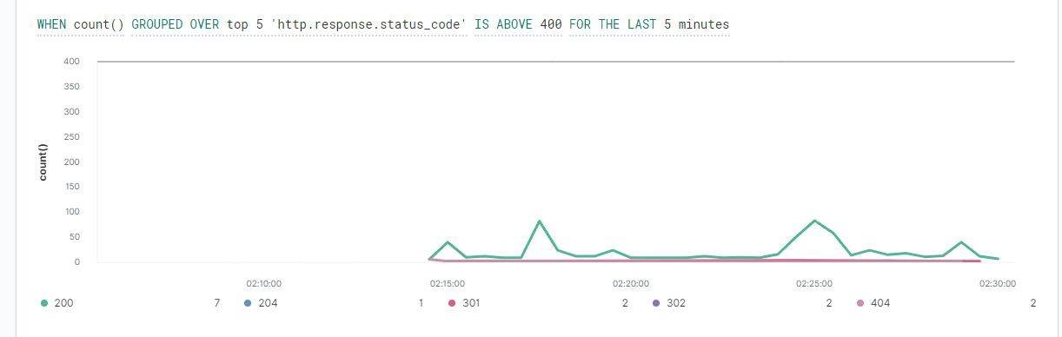
Queries packetbeat indices for HTTP status code responses.
Triggers when the grouped count over top 5 http status response codes exceeds 400 in the last 5 minutes.
●

Slide 34
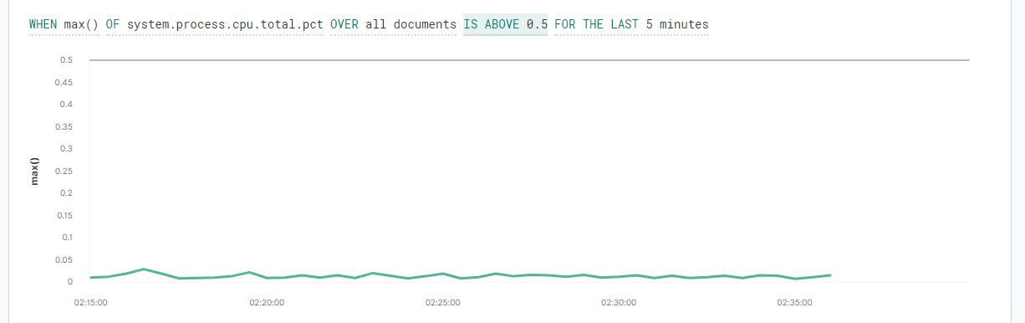
Queries metricbeat indices for system processes as a percent of CPU activity.
Alert threshold set to trigger when percentage of CPU activity exceeds 50%.
●

Slide 35
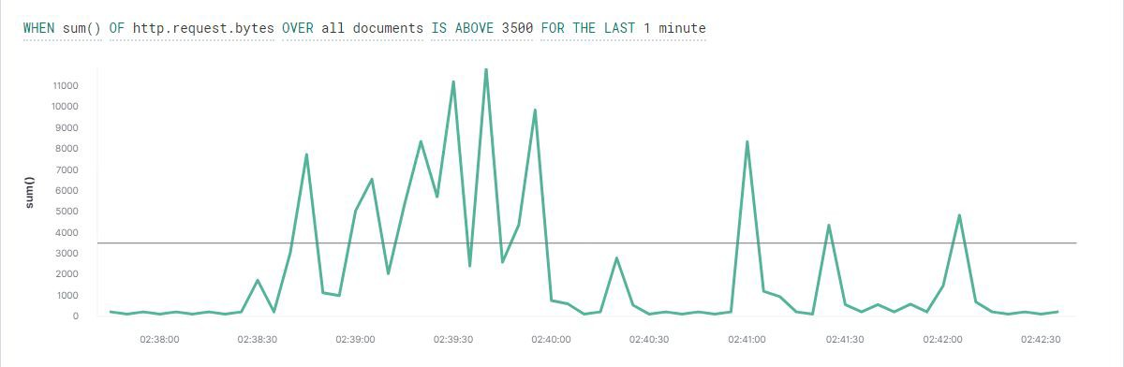
Queries packetbeat to monitor HTTP data requests.
Threshold alert triggers when the sum of request http.request.bytes exceeds 3500 events over the previous minute.
●

Slide 36
Hardening
36

Slide 37
Hardening Against Open Port 22 SSH and Weak Password Vulnerability on Target 1
Recommended to disallow access via Port 22 OpenSSH.
Closing this port will disable these ssh connections to the server, preventing the access achieved during Red Team operations.
Hardening password policy and error handling reporting to mitigate attempts at reconnaissance and brute force may further mitigate issues if SSH is erroneously left open.

Slide 38
Hardening Against WordPress Conﬁguration and SQL Database Vulnerability on Target 1
Recommended to conﬁgure and salting hash the wordpress database login information to prevent unwanted access to the SQL database.
With the information unhashed and easily accessible, root access to the SQL database and it’s information is easily attained.

Slide 39
Hardening Against Privilege Escalation on Target 1
Role and permission management of new and existing users is essential to preventing vertical or horizontal escalation of privileges to unauthorized users.
Recommended to set correct ﬁle permissions for user accounts, maintain control over assigned roles and permissions for any existing or new user accounts.

Slide 40
Hardening Against WordPress XML-RPC Related Vulnerabilities on Target 1
Update WordPress version.
Disable XML-RPC API settings if still enabled (patched after WordPress 3.5.1, as well as post version 3.9.2)
xmlrpc.php can be disabled by plugin function utilizing the following as part of theme functions or in better practice as a plugin:
add_filter( 'xmlrpc_enabled', ' return_false' );

Slide 41
The patch was updated in WordPress 3.5.1
Add to the following wp-conﬁg.php after update

Slide 42
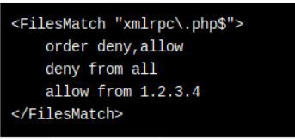
Remove php ﬁle from root of WordPress folder
Disable the plug-in for XML-RPC from all IP with exceptions

Slide 43
Implementing Patches

Slide 44
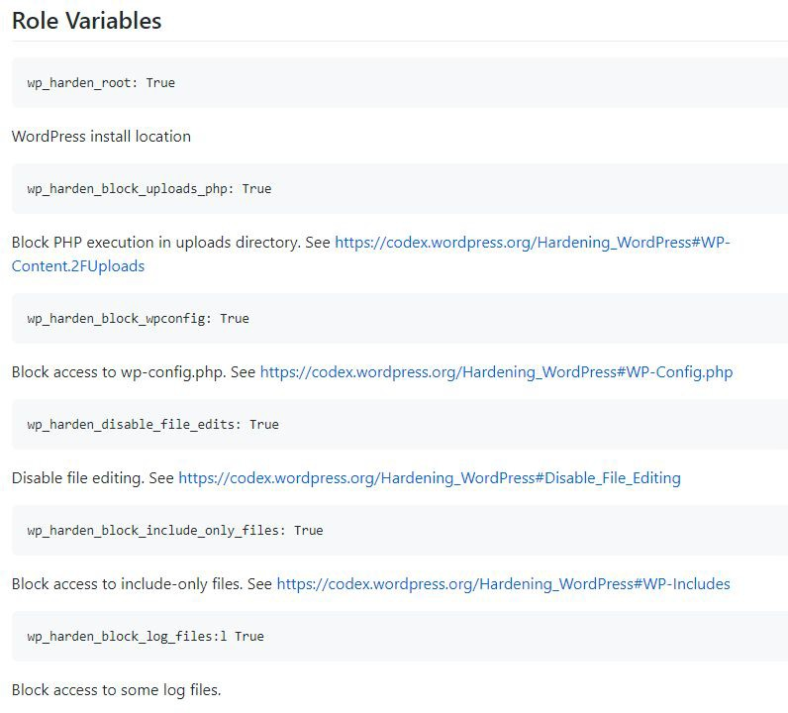
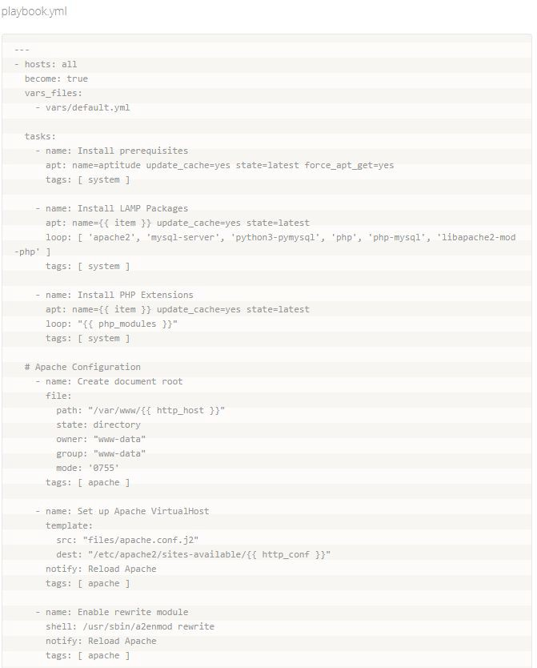
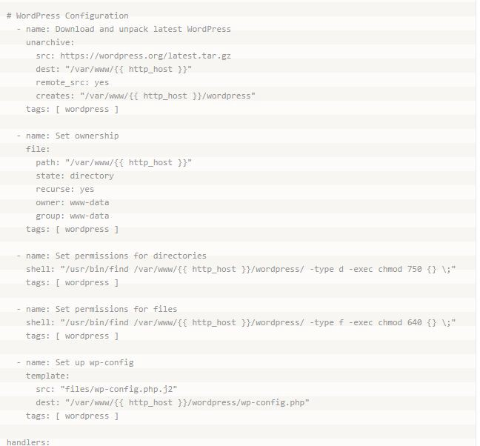
Implementing Patches with Ansible
Ansible overview
Ansible Playbook would implement hardening and updating measures to WordPress Conﬁguration ﬁles, while properly assigning permissions/roles to users

Slide 45
NETWORK ANALYSIS

Slide 46
Table of Contents
This document contains the following resources:
Traffic Profile
Normal Activity
Malicious Activity

Slide 47
Traﬃc Proﬁle

Slide 48
Our analysis identiﬁed the following characteristics of the traﬃc on the network:
 | Feature | Value | Description
 | Top Talkers (IP Addresses) | 172.16.4.205 (49.4%) 185.243.115.84 (29.2%) 10.0.0.201 (18.7%) | Machines that sent the most traﬃc.
 | Most Common Protocols | TCP (88.7%) UDP (11.2%) NONE (0.1%) | Three most common protocols on the network.
 | # of Unique IP Addresses | 808 | Count of observed IP addresses.
 | Subnets | 10.6.12.0/24 172.16.4.0/24 10.0.0.0/24 | Observed subnet ranges.
 | # of Malware Species | 1 (june11.dll) | Number of malware binaries identiﬁed in traﬃc.

Slide 49
Purpose of Traﬃc on the Network
Behavioral Analysis
Users were observed engaging in the following kinds of activity.
N o r m a l Activity
For example: Watching YouTube, surﬁng the web.
Suspicious Activity
For example: Sending malware, phishing, torrenting copyrighted material.

Slide 50
Normal Activity

Slide 51
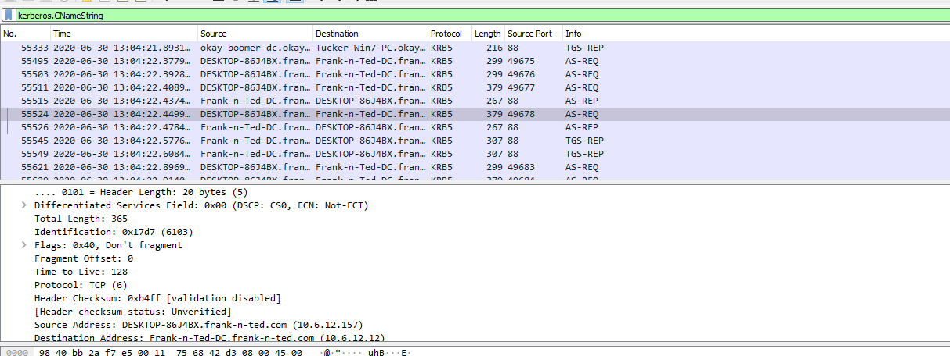
Web Server Creation
ip.src==10.6.12.12
Domain Name: frank-n-ted.com
Domain Controller IP: 10.6.12.12

Slide 52
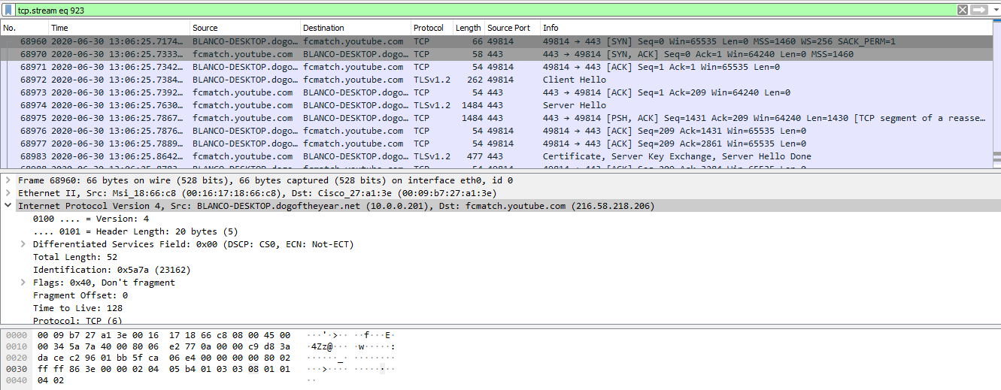
Web Browsing

Slide 53
Malicious Activity
53

Slide 54
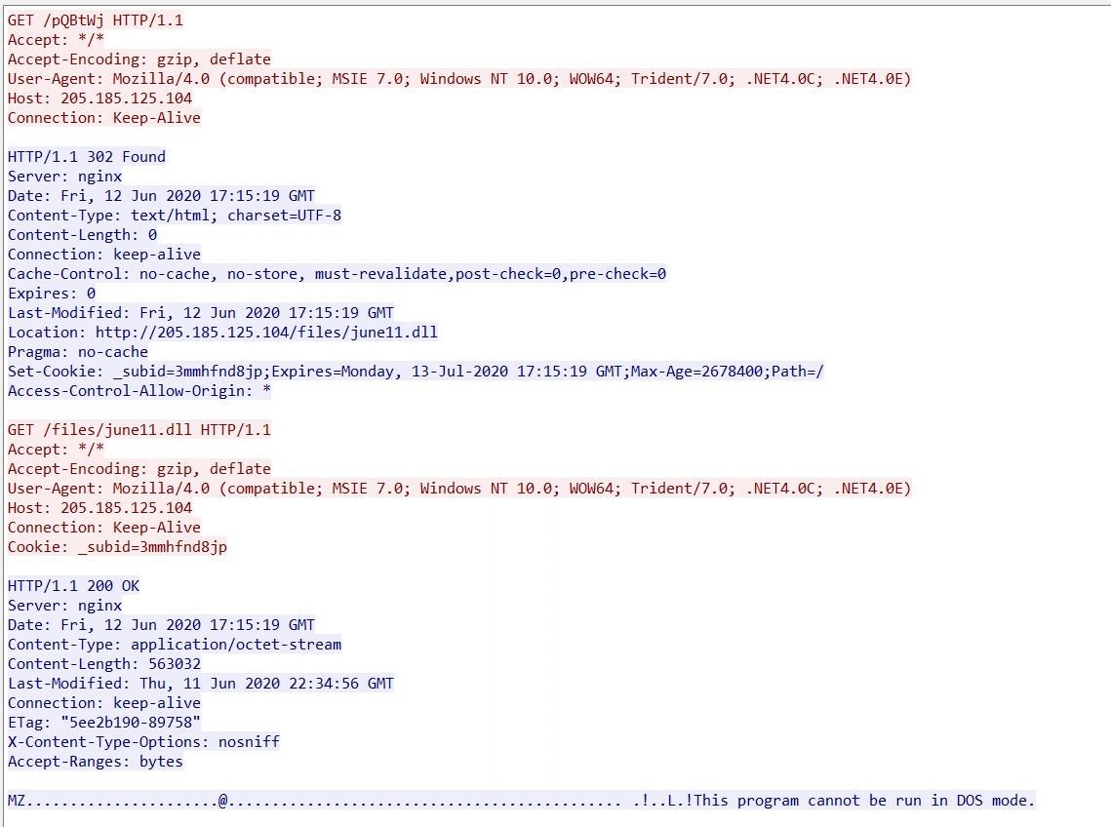
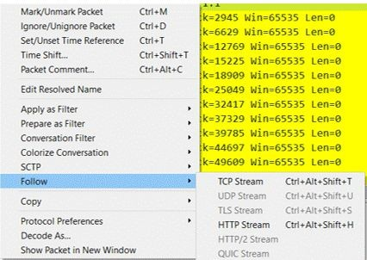
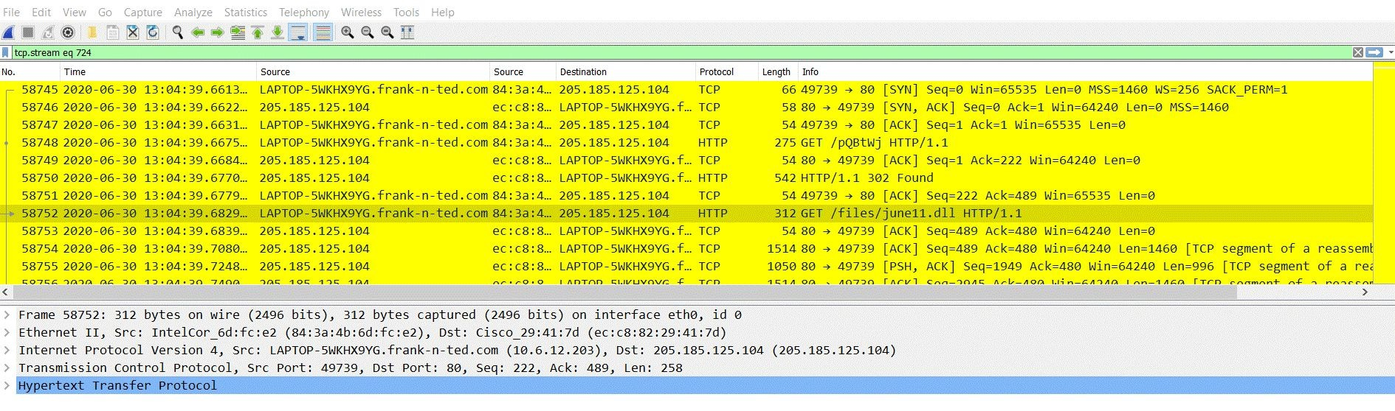
Wireshark-Time Thieves
Malware downloaded to 10.6.12.203
june11.dll
ip.src==10.6.12.203

Slide 55
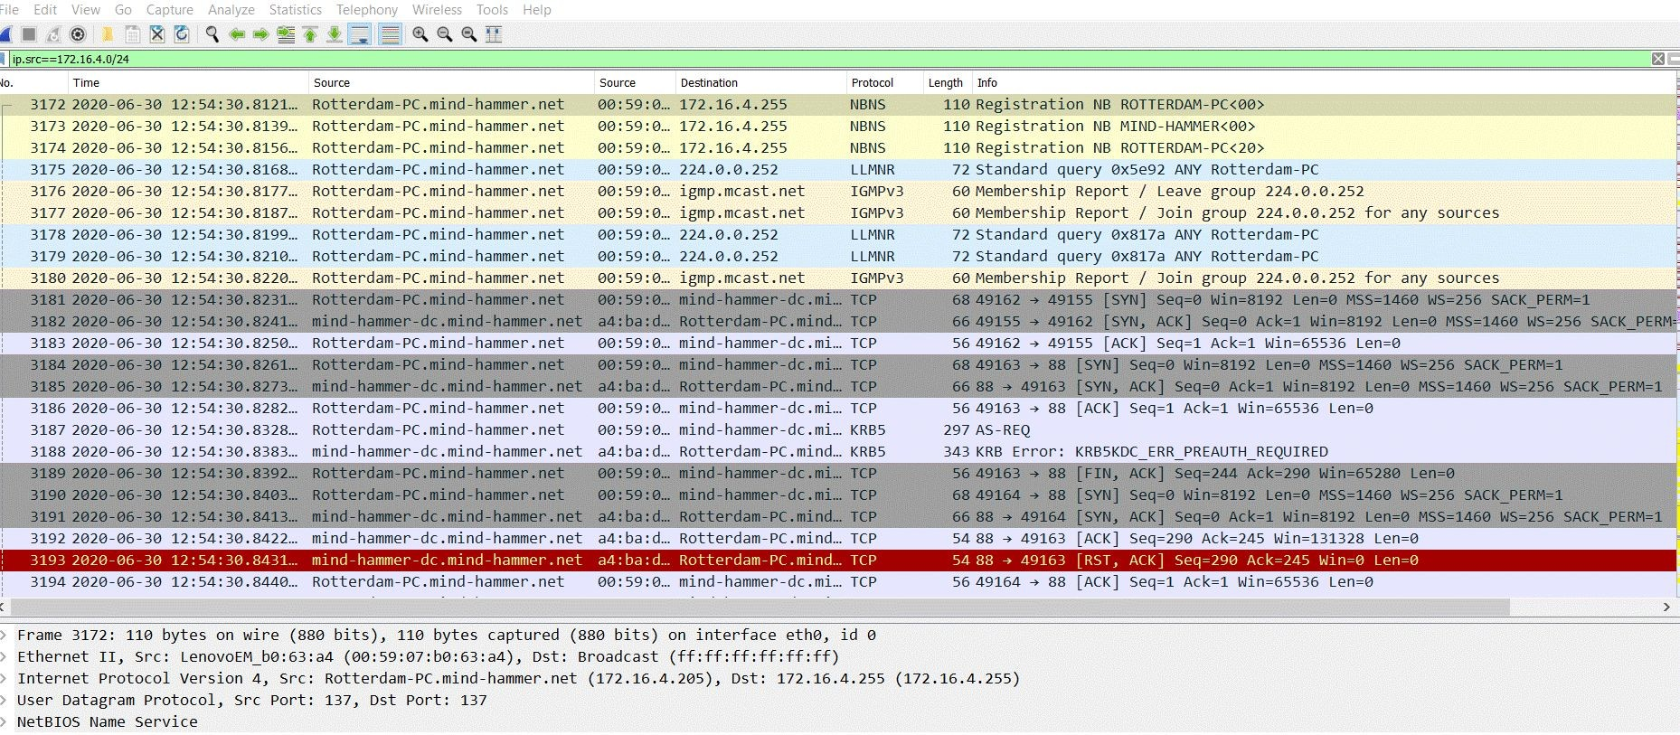
Wireshark-Vulnerable Windows Machines
ip.src==172.16.4.205
Host Name: ROTTERDAM-PC
IP Address: 172.16.4.205
MAC Address: 00:59:07:b0:63:a4

Slide 56
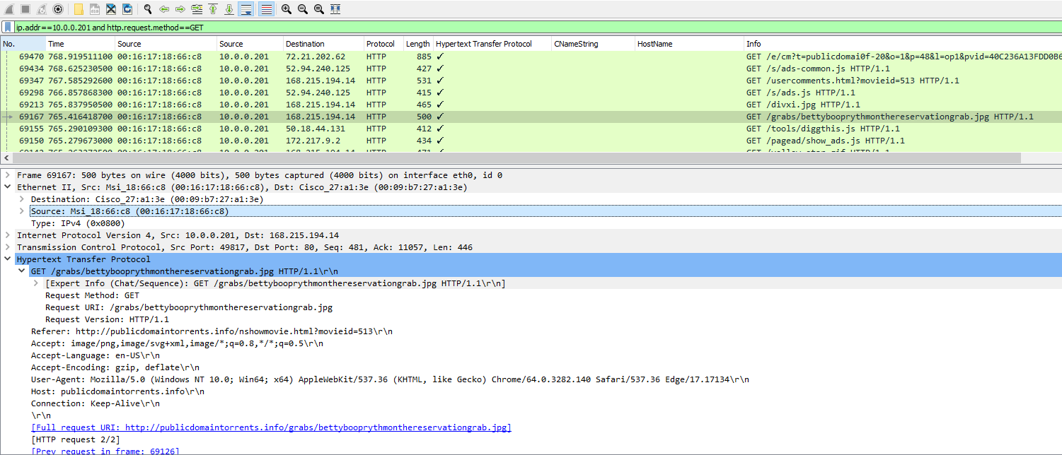
Torrent file: bettybooprythmonthereservationgrab.jpg

Slide 57
CONCLUSION

Slide 58

Red Team - The 2 targets contained a plethora of vulnerabilities that were exploited mainly through WordPress
Blue Team - We found effective ways to potentially mitigate the vulnerabilities that the Red Team exploited
Network - Using Wireshark, we logged and analyze traﬃc for suspicious and found more weak points.
Update your software, keep patching, and never get comfortable!

Slide 59
The End

